Slide 1
ACM ITiCSE’20 June-15-19, Trondheim Norway
Resilience and Effective Learning in First-Year Undergraduate Computer Science
Tom Prickett¹, Julie Walters¹, Longzhi Yang¹, Morgan Harvey² and Tom Crick³
¹ Department of Computer and Information Sciences, Northumbria University
² Information School, University of Sheffield
³ School of Education/Department of Computer Science, Swansea University

Slide 2
Overview
Background and Context
Research Methods
Findings
Limitations and Constraints
Conclusions and Implications
References

Slide 3
Background and Context
Your thoughts: https://bit.ly/ITiCSEResilience
Computer Science is challenging and learning programming particularly challenging [1][6]
Maintaining effective learning requires competence and resilience [4][5][10]
This is a preliminary study into two measures of positive psychology [8] and student success: Duckworth’s 12-item Grit Scale [3] and Nicholson McBride Resilience Quotient (NMRQ) [2]
Grit 12-Item Scale: the passion and perseverance for a singularly important goal [3]
https://angeladuckworth.com/grit-scale/ (This is the 10 point scale - we use the 12 point scale)
Nicholson McBride Resilience Quotient: quality that helps you turn adversity into advantage and threat into opportunity [2]
We use short 12 question version (https://bit.ly/ITiCSENMRQ)

Slide 4
Your thoughts: https://bit.ly/ITiCSEResilience
Research Methods
Ethical approval obtained
In February 2019 students completed the two surveys in a lecture via the University’s electronic learning platform
Students were:
Provided their results
Interpretation of their results
Guidance provided and further support offered
Consent explicitly gained
At end of year subject marks and attendance obtained
A first-year BSc(Hons)/MComp Computer Science cohort.
Sample size
Grit: N=58
Resilience: N=50
Analysis
Correlation Analysis
Exploration of predictive strength via logistic regression
We are not building a predictive model

Slide 5
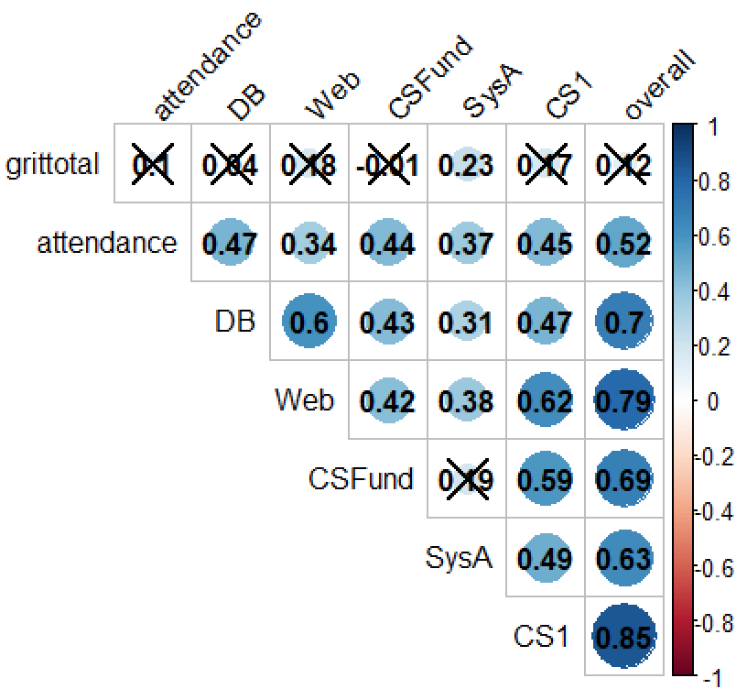
Findings - Grit Correlation Analysis
Your thoughts: https://bit.ly/ITiCSEResilience
Not statistically significant at 1% level

Slide 6
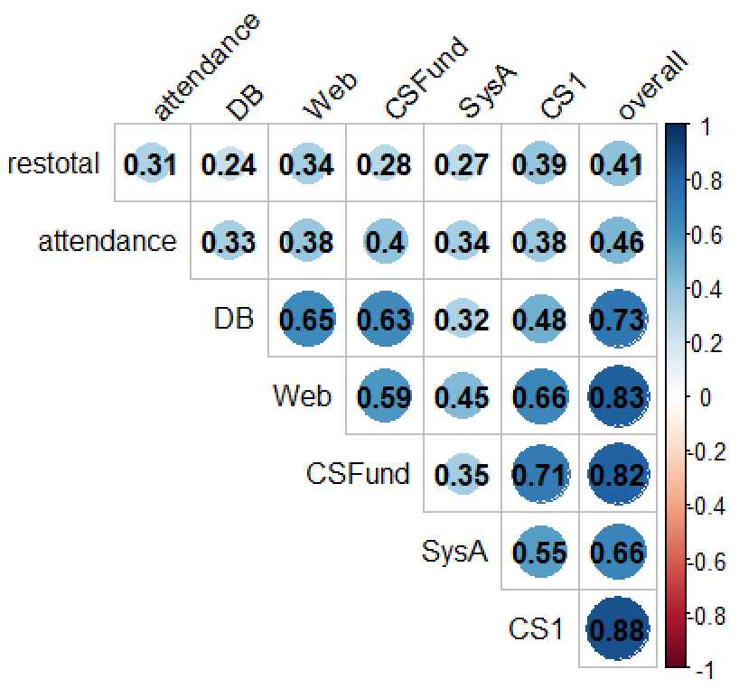
Findings – Resilience (NMRQ) Correlation Analysis
Your thoughts: https://bit.ly/ITiCSEResilience
Statistically significant at 1% level

Slide 7
Findings - Logistic Regression – 1st Class Honours – Average over 70%
Model | x₁ | p value | Accuracy | AUC
Overall ~Grit | 0.385 | 0.385 | 0.59 | 0.555
SysA ~ Grit | 0.724 | 0.119 | 0.64 | 0.636
Overall ~ Resilience | 0.135 | 0.042* | 0.66 | 0.671
CS1 ~ Resilience | 0.154 | 0.026* | 0.68 | 0.691
DB ~ Resilience | 0.151 | 0.027* | 0.64 | 0.681
Web ~ Resilience | 0.106 | 0.106 | 0.59 | 0.616
CSFund ~ Resilience | 0.181 | 0.015* | 0.7 | 0.713
SysA ~ Resilience | 0.08 | 0.192 | 0.6 | 0.637
Attendance ~ Resilience | 0.125 | 0.058 | 0.56 | 0.657
* = significant at p <0.05

Slide 8
Limitations
Your thoughts: https://bit.ly/ITiCSEResilience
Single institution
Higher education / first-year of a degree
Correlation not causation
Small sample size
Sample bias - non attendees
Solely quantitative study
Sample size not large enough for consideration of other factors (for example, gender)
Risk of identification of individual students

Slide 9
Conclusions and Implications
Your thoughts: https://bit.ly/ITiCSEResilience
12-item resilience scale could be a factor in promoting success
Not true for the 12-item grit scale
Consistent with other work [9]
A number of possibilities for future work related to:
Transition
learner attitudes, behaviours and dispositions,
teaching and assessment
Possible further work:
i) Initiatives related to the active development of student resilience can be deployed and evaluated
ii) Replicating the study with larger cohorts and at other schools / colleges /universities to validate, increasing the sample size and strengthening the statistical basis.
iii) Using resilience in predictive models alongside other key factors in order to further augment and enhance the prediction of student success.

Slide 10
Selected References
[1] Jens Bennedsen and Michael E. Caspersen. 2019. Failure Rates in Introductory Programming: 12 Years Later. ACM Inroads 10, 2 (April 2019), 30–36. https://doi.org/10.1145/3324888
[2] Jane Clarke (2010). Resilience: bounce back from whatever life throws at you. Crimson Publishing, USA.
[3] Angela L Duckworth, Christopher Peterson, Michael D Matthews, and Dennis R Kelly. 2007. Grit: perseverance and passion for long-term goals. Journal of personality and social psychology 92, 6 (2007), 1087. https://doi.org/doi/10.1037/0022-3514.92.6.1087
[4] Sarah Holdsworth, Michelle Turner, and Christina M. Scott-Young. 2018. . . .Not drowning, waving. Resilience and university: a student perspective. Studies in Higher Education 43, 11 (2018), 1837–1853. https://doi.org/10.1080/03075079.2017.1284193
[5] Ann S. Masten and J. Douglas Coatsworth. 1995. Competence, resilience, & psychopathology. In Wiley series on personality processes. Developmental psychopathology, Vol. 2. Risk, disorder, and adaptation, D. Cicchetti & D. Cohen (Ed.). Vol. 2. Wiley, New York, 715–752
[6] Leo Porter, Cynthia Bailey Lee, and Beth Simon. 2013. Halving Fail Rates Using Peer Instruction: A Study of Four Computer Science Courses. In Proceeding of the 44th ACM Technical Symposium on Computer Science Education (Denver, Colorado, USA) (SIGCSE ’13). ACM, New York, NY, USA, 177–182. https://doi.org/10.1145/2445196.2445250
[7] Tom Prickett, Morgan Harvey, Julie Walters, Longzhi Yang and Tom Crick, 2020, Resilience and Effective Learning in First Year Undergraduate Computer Science, In Proceedings of the 2020 ACM Conference on Innovation and Technology in Computer Science Education(ITiCSE 2020). ACM In Press
[8] Martin E. P. Seligman. 2006. Learned Optimism: How to Change Your Mind and Your Life. Vintage, USA
[9] Nikki Sigurdson and Andrew Petersen. 2018. An Exploration of Grit in a CS1 Context. In Proceedings of the 18th Koli Calling International Conference on Computing Education Research (Koli, Finland) (Koli Calling ’18). ACM, Article 23, 23:1–23:5 pages. https://doi.org/10.1145/3279720.3279743
[10] Caroline Walker, Alan Gleaves, and John Grey. 2006. Can students within higher education learn to be resilient and, educationally speaking, does it matter? Educational Studies 32, 3 (2006), 251–264. https://doi.org/10.1080/03055690600631184

Slide 11
Any questions?
Questions by email welcome to:
Tom Prickett, Northumbria University tom.prickett@northumbria.ac.uk
Julie Walters, Northumbria University tom.prickett@northumbria.ac.uk
Your thoughts also welcome at:
https://bit.ly/ITiCSEResilience

